Slide 1
Final Project
Housing Authority Management System
By Hamad Almansoori

Slide 2
Introduction
The proposed project provides online management for Housing Societies.
The administrator login can be used to do tasks like approve user proposals, change database entries and add new content to the website.
The user login can be used by individuals for buying, selling houses or generating event requests or launching complaints.
The free user can only view the website and send query to the administrator.

Slide 3
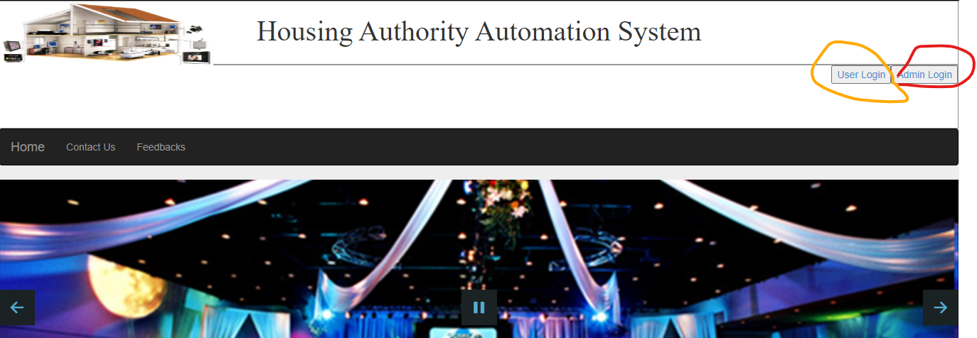
Main page
The main page has the interface shown in the picture
User Login: This can be done by clicking user login
button (orange circle)
Admin Login: This can be done by clicking admin login
button (red circle)

Slide 4
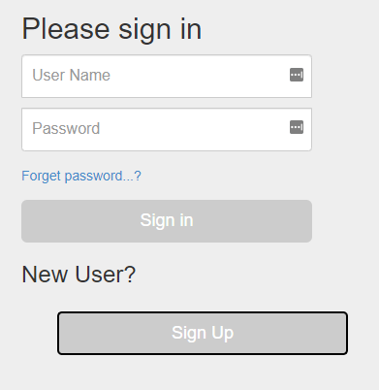
User Login
When user signin button is clicked following screen is displayed.
New user can signup and registered users can login with their credentials.

Slide 5
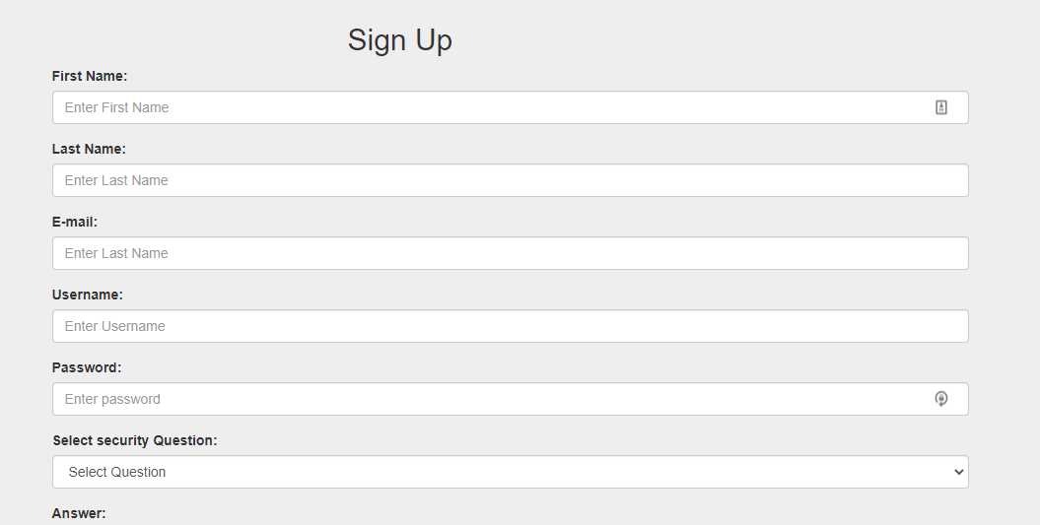
User Signup
When a new user wants to register this screen is displayed

Slide 6
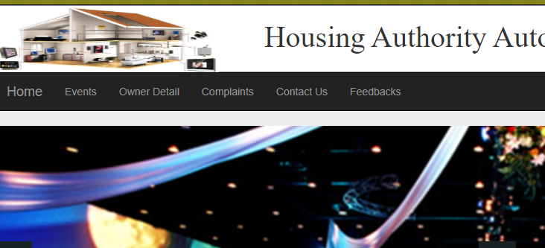
User Signed IN
When user logs in, he can see the interface shown above
User can lodge complaints and generate event requests
He can also search for owners of property by entering house numbers

Slide 7
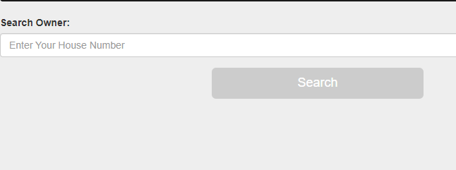
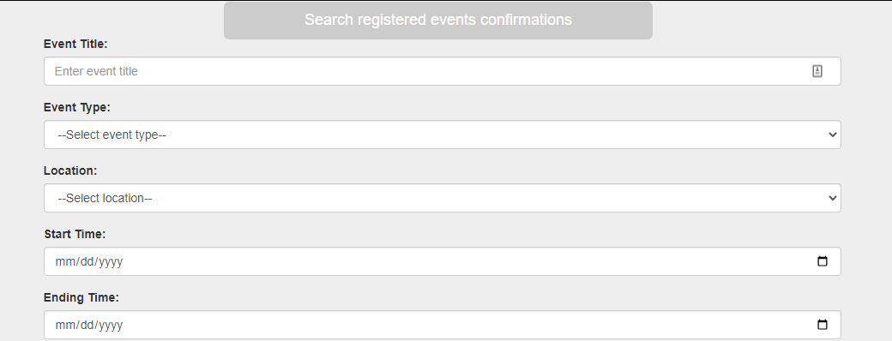
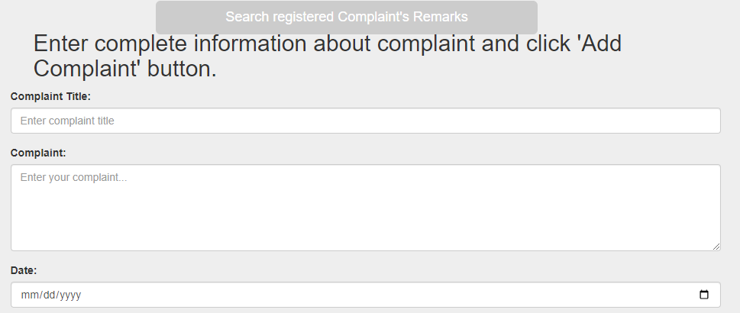
User Login details
Owner Detail Tab
Events Tab
Complaint Tab

Slide 8

Admin Signed IN
After admin Signin, he can see the interface shown
He can add new owners, house details and see complaints from users and their feedbacks

Slide 9
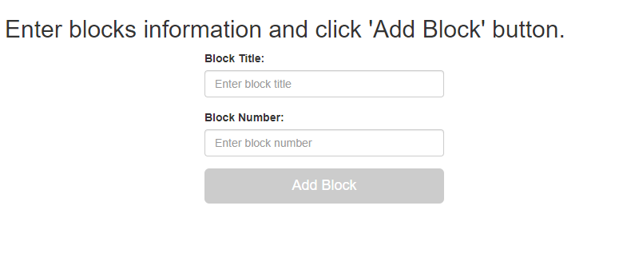
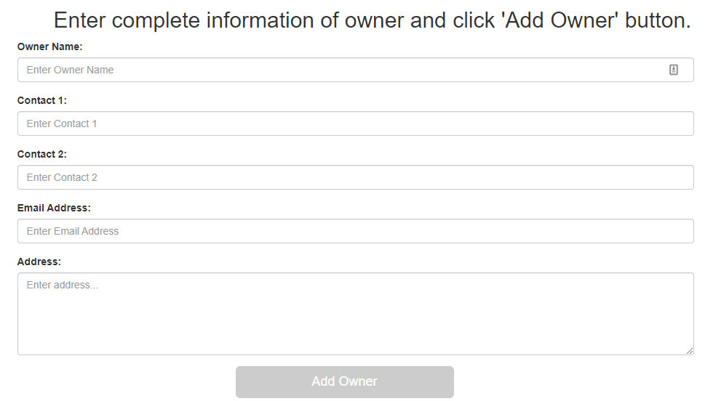
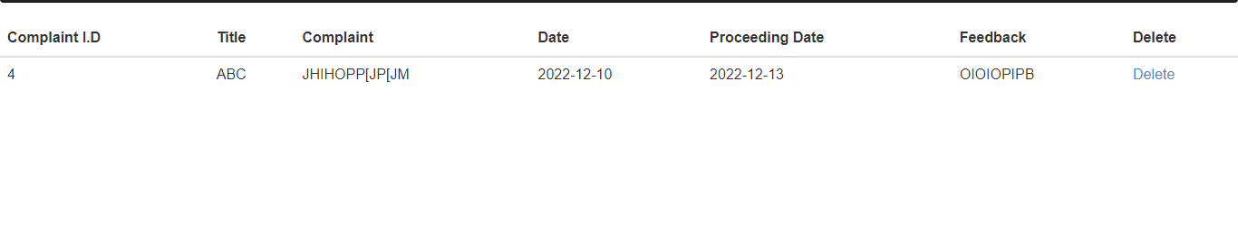
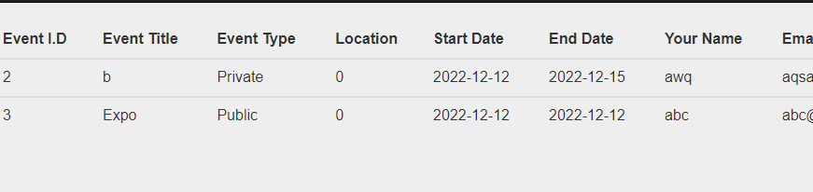
Admin SignIN details
Blocks Tab
Owners Tab
Complaints Tab
Events Tab

Slide 10
Future Work
Add payment option on the website
Improve user GUI
Improve overall working

Slide 11
Thanks

